Slide 1
Sekhar Rangam
Technical Architect
Bridgei2i Analytics Solutions
PRESENTER | 27-July-2019

Slide 2
Plant Monitoring, Notifications and Auto Water System using AWS IoT
PRESENTER | DATE

Slide 3
Agenda
Overview
Conceptual View
Capabilities
Architecture

Slide 4

Home Drip Overview
If you are going on a vacation or so and are worried about your house plants at home, don't worry with Plant Monitoring using Mobile App push notifications & Auto Water System using AWS IoT you can set up your plant to be watered as often as you like and control and monitor from remote location using mobile app connected to AWS IoT

Slide 5
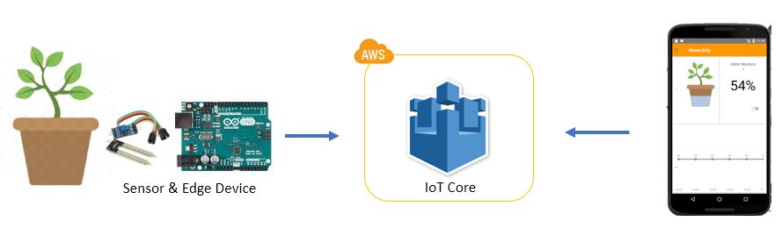
Conceptual View

Slide 6
Home Drip Capabilities
Monitor water moisture levels in mobile app from remote location
Auto water supply when moisture level falls below threshold value
Email and Push Notifications when moisture level falls below threshold value
Supply water by force
Schedule water supply
Configure the threshold values

Slide 7
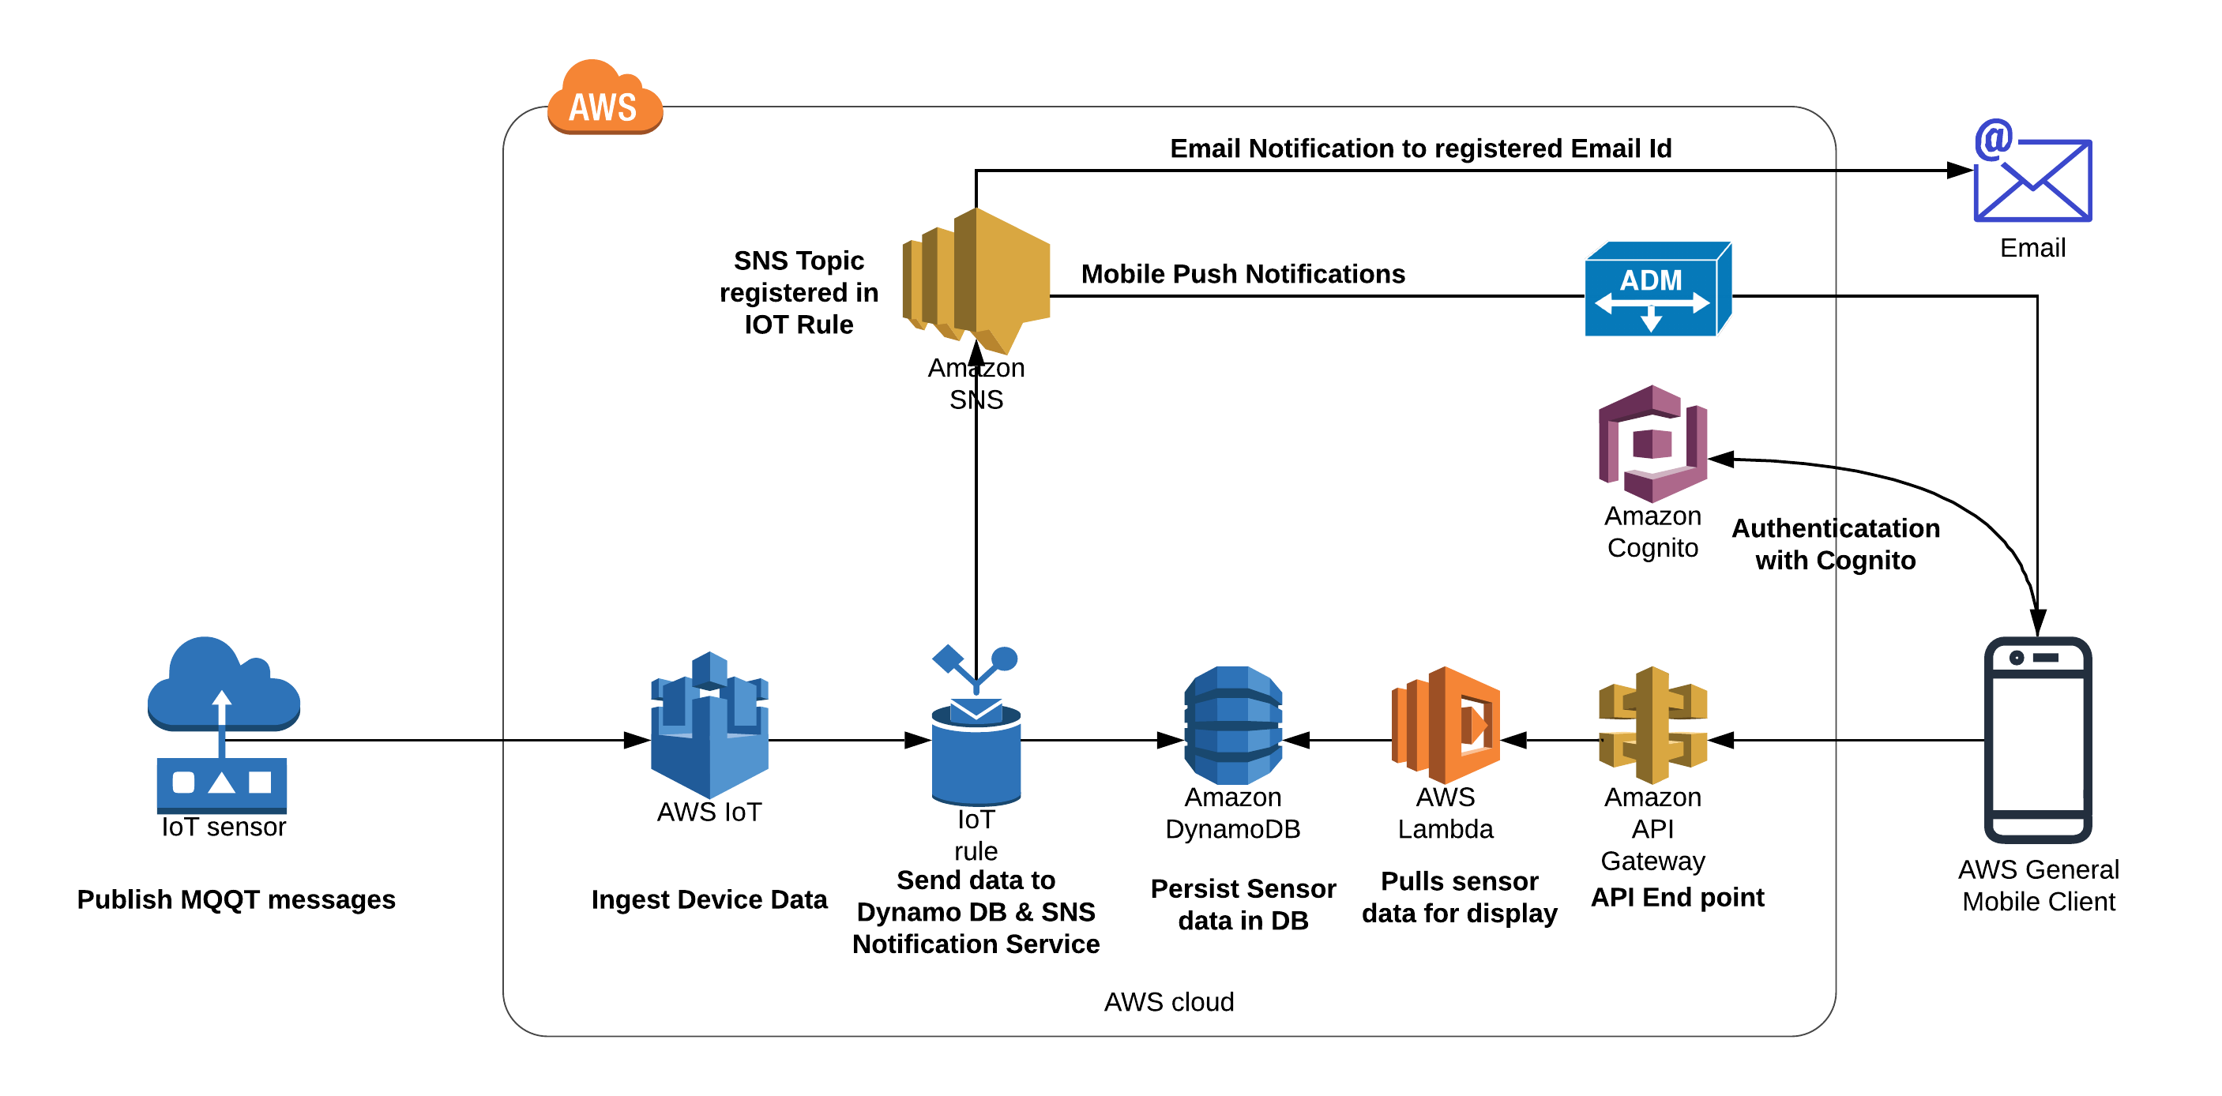
Technical Architecture

Slide 8
Components, Services and technologies Considerations
Edge Device
Arduino Board
Water Motor Pump
Sensor
Mobile App
React Native
AWS
IoT Core
Dynamo database
AWS Gateway
Lambda Function
SNS
AWS Amplify
AWS Cognito

Slide 9
AWS IoT
AWS IoT Core is a platform that enables you to connect devices to AWS Services and other devices, secure data and interactions, process and act upon device data, and enable applications to interact with devices even when they are offline.

Slide 10
AWS IoT Key features
Device Gateway
The Device Gateway serves as the entry point for IoT devices connecting to AWS. The Device Gateway manages all active device connections and ensure that devices are able to securely and efficiently communicate with AWS IoT Core.
Message Broker
The Message Broker is a high throughput pub/sub message broker that securely transmits messages to and from all of your IoT devices and applications with low latency.
Certificate Authority
AWS IoT Core provides mutual authentication and encryption at all points of connection

Slide 11
AWS IoT Key features
Device Shadow
With AWS IoT Core, you can create a persistent, virtual version, or Device Shadow, of each device that includes the device’s latest state so that applications or other devices can read messages and interact with the device
Rule Engine
The Rules Engine evaluates inbound messages published into AWS IoT Core and transforms and delivers them to another device or a cloud service, based on business rules you define
The AWS IoT Device SDK
Helps you easily and quickly connect your hardware device or your mobile application to AWS IoT Core using the MQTT, HTTP, or WebSocket's protocols

Slide 12
Message Broker

Slide 13
Topics

Slide 14
Device Shadow
{ "state": {
"reported": {
"moisture": “85" }
},
"metadata": {
"reported": { "moisture": { "timestamp": 1539272338 } }
},
"version": 19, "timestamp": 1539272436
}

Slide 15
Device Shadow – Few Endpoint Interacts
Update to this thing shadow
$aws/things/testSensor/shadow/update
Update to this thing shadow was accepted
$aws/things/testSensor/shadow/update/accepted
Update this thing shadow documents
Get this thing shadow
$aws/things/testSensor/shadow/get

Slide 16
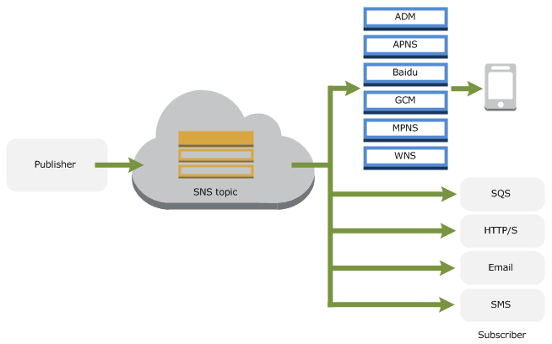
Rules Engine - Email and Mobile Push Notifications
IOT Rule

Slide 17
AWS Amplify

Slide 18
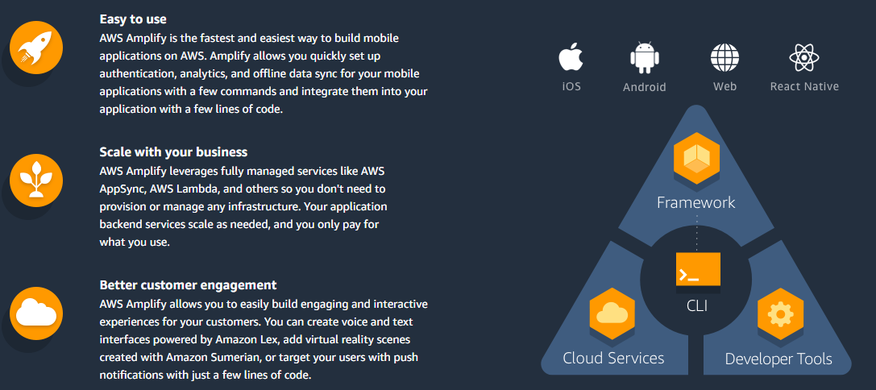
AWS Amplify – Mobile APP

Slide 19
Demo

Slide 20
Best Practices

Slide 21
AWS identity and access management
Control who can do what
Create users, groups, roles and permission to interact with any service

Slide 22
AWS IoT Permissions
Manage group of things at topic level in IoT Core
Control what a thing is allowed to do
Connect, Publish, Subscribe, Receive
Create a X.509 certificate from CSR
Create a policy and attach to certificates

Slide 23
Register the device with AWS IoT
Private key, authenticate the device
Certificate, register the device with IoT
Root certificate authority, authenticate with IoT

Slide 24
Securing Devices
Each device should use a unique private key and certificate for authentication

Slide 25
Securing user access
Amazon Cognito identity pools
Manage user identities
Authenticate Cognito for fine grained permissions and IoT policies
Secure services like API Gateway and Lambda functions using Cognito

Slide 26
Thank You
Sekhar Rangam
Engineering Manager
sekhar.rangam@bridgei2i.com
M: +91-9916919145
Reach me at:
https://www.linkedin.com/in/sekharrangam/

